Slide 1
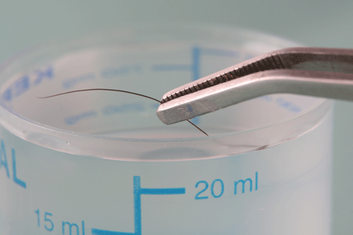
DETERMINATION OF ORIGIN, RACE, SEX, SITE FROM HAIR

Slide 2
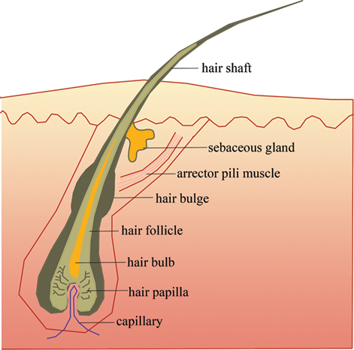
INTRODUCTION
Hair is protein filament that grows from follicles in the dermis.
On cross-sectioning on hair shaft-Medulla, Cortex and cuticle.
3 types of hair- Vellus , Intermediate and Terminal. And also classified based on sub-ethnic group.
The 3 stages of growth-Anagen , Catagen and Telogen.
Melanin-Formation of pigmentation takes place at Melanosome.

Slide 3
Hair Forensics
1857 France - first forensic science reports on scientific study on hair, since the beginning of the 1900s played major role in courts .
Hair is class evidence
From hair one can determine:
1) If the source is human or animal
2) Race
3) Origin of the location on the source’s body.
4) Sex of an individual.
5) Nuclear and mitochondrial DNA (mtDNA)

Slide 4
DETERMINATION OF ORIGIN
MEDULLA
It’s the central core that may be present in the hair.
It’s ratio of size to the diameter of the shaft may vary from species to species.

Slide 5
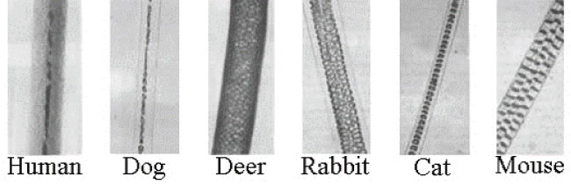
Medulla
In humans the medulla is discontinuous mostly. This is also considered as one of the identifying features of human and animal hair.
In Most Animals the medulla is continuous and may follow very different patterns that from the Human hair.

Slide 6
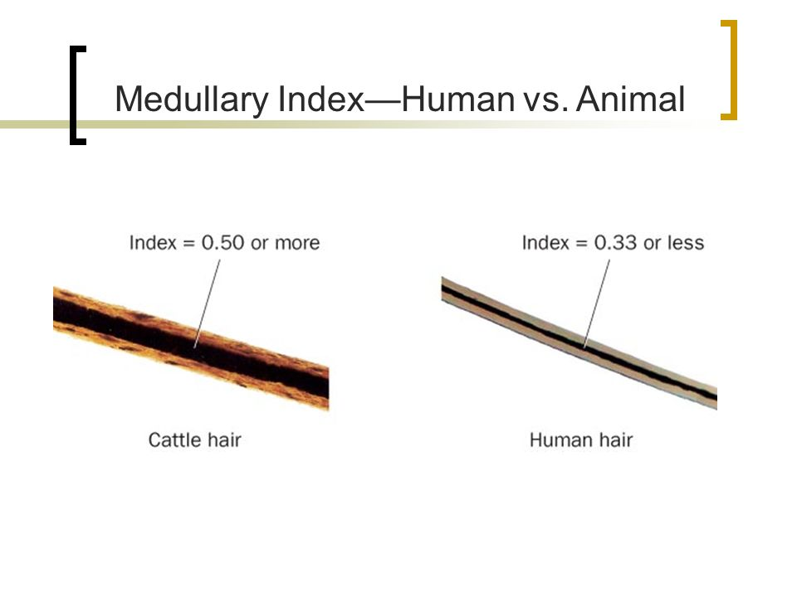
Medulla
The diameter of medulla in humans is generally , less than overall diameter of the shaft .
This ratio is known as the Medullary Index.
The medulla in animals is generally greater than one third the overall diameter of shaft

Slide 7
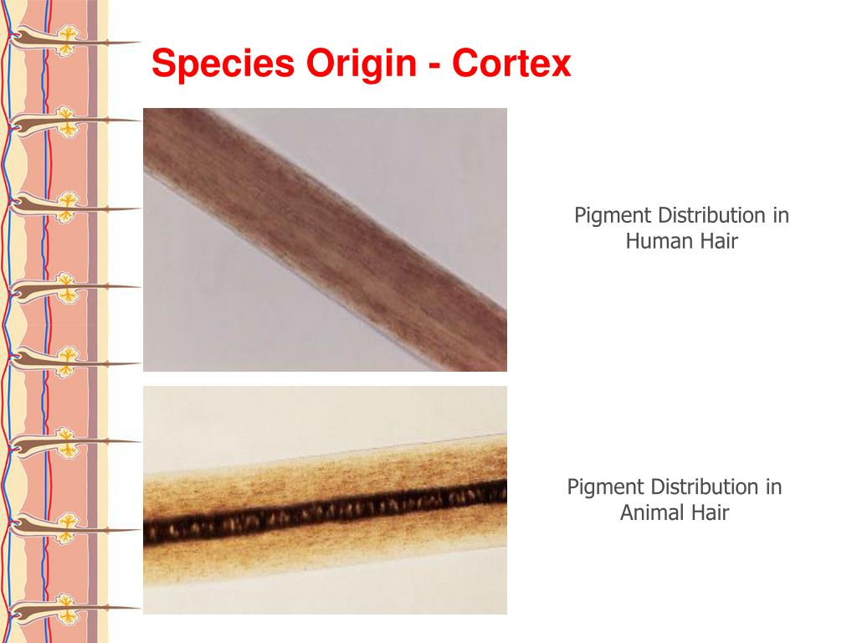
Distribution of Pigment
IN HUMAN HAIR – The distribution of hair is towards the cuticle.
IN ANIMALS – The pigment distribution is basically concentrated towards the centre or the medulla .

Slide 8
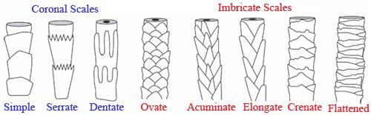
Scales
Cuticle is basically made from scales and they may have different pattern and varies from species to species.
In Humans – These scales are usually in imbricate pattern.
In Animals – These scales are in coronal or ring form.

Slide 9
EXAMINATION OF HAIR – TO DETERMINE SPECIES
TEMPORARY MOUNT
SCALE CASTING
PERMANENT MOUNT
CROSS SECTIONING
MICROMETRY

Slide 10
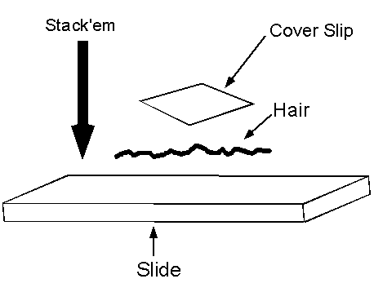
TEMPORARY MOUNT
Making a temporary mount is easy comparitively.
Take a clean slide mount a hair strand put a drop of glycerine and put coverslip over it.
Observe the morphological characterstics.

Slide 11
SCALE CASTING
THERE ARE TWO METHODS TO DO THIS.
(A) CELLULOSE ACETATE METHOD –
On a clean slide take a thin layer of cellulose acetate paste and the mount a hair strand over it using forceps and then, press over it with another slide. Dry it for 2-3 minutes.
(B) POLAROID COATER METHOD –
On clean slide take a hair strand and secure both ends with cellophane tape , use Polaroid film coater along the length of the hair 2-3 times , allow it to dry for approx 24 hours. Take of the tape and peel off the hair, using a scalpel peel of the excess and then carefully observe the scale under the microscope.

Slide 12
PERMANENT MOUNT
Place the hair strand and put a drop of xylene, add permanent mount medium.
Place the coverslip and allow to dry for 48 hours.
Observe the morphological features.

Slide 13
CROSS SECTIONING
Clean the hair starnd in ether and ethanol soluyion in the ratio of 1:1.
Then put the samples in a block of molten wax.
Then cross sections can be taken with a blade or microtone to a thickness 5-10 microns.
Dissolve the wax with a drop of xylene and prepare a permanent mount and observe.

Slide 14
MICROMETRY
With the help of the micrometer we can take different measurements of hair strands that will be helpful in understanding the difference between hair of different species , especially it is helpful in taking the medullary indices.

Slide 15
DETERMINATION OF SITE
The removal of the hair strand from the body does not only mean of physical contact .
The hair sample can be used in various types of investigation .
It is also used in determining the presence of toxic substances .

Slide 16
Forensic scientist has distinguished body hair in six types
Head hair
Eyebrow and eyelashes
Beard and moustache hair
Underarm hair
Pubic hair
Auxillary or body hair
Hair of different parts can be determined by their cross section.
Head hair is elliptical or circular
Eyebrow and eyelashes are also circular
Beard hair tend to be thick and triangular
Body hair can be oval or triangular
Hair of arm and leg have blunt tip and may be frayed at the end
The body portion where hair is regularly shaved trimmed or cut have blunt tips .
The buckling is seen in pubic hair and diameter may very largely
The other way to examine the site of hair can be done through chemical examination for toxic or other substances.

Slide 17
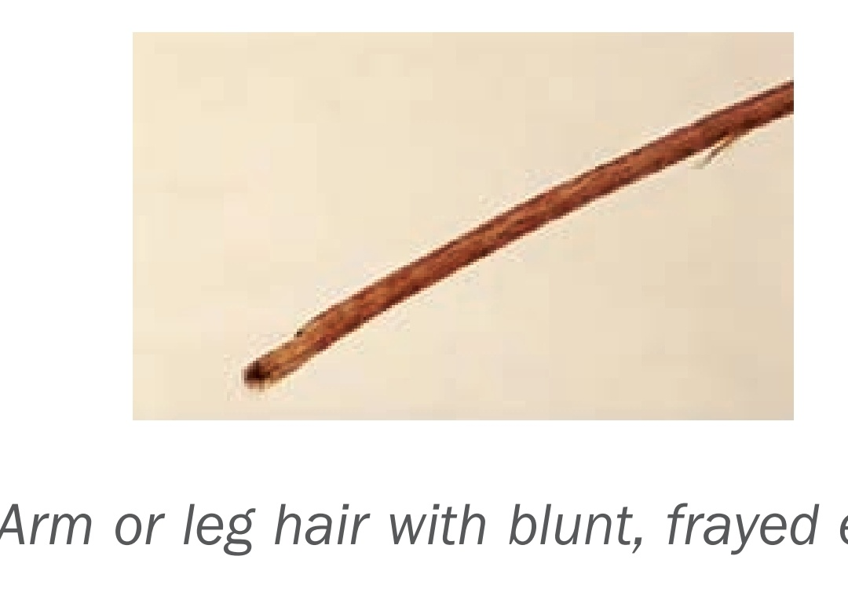
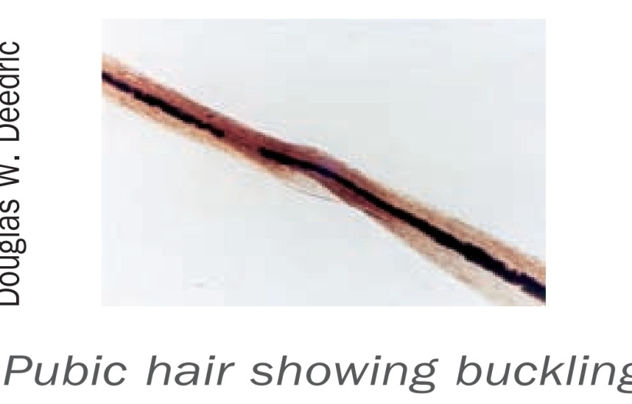
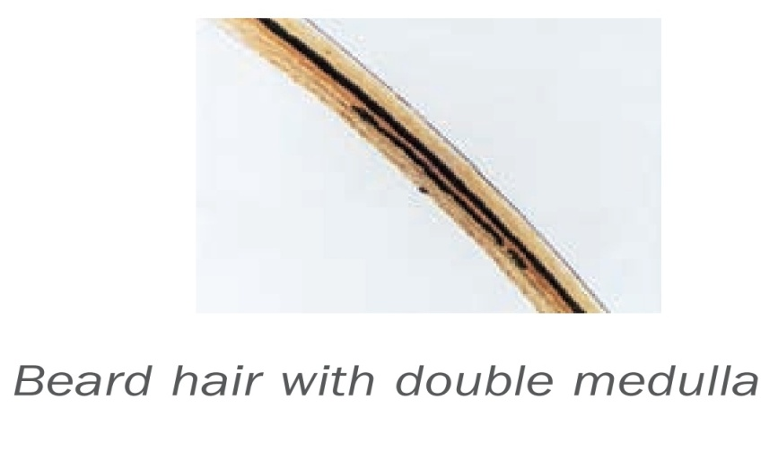
Cross-section of hair from different site:

Slide 18
DETERMINATION OF SEX
Sex determination can be done even in decomposed bodies.
If hair is with roots, we can determine sex from DNA profiling.
Barr bodies identify female sex.
Presence of Fluorescent Y bodies identify female sex.
Present studies indicates that reliable sex identification is possible upto 8 months when samples are kept in dried conditions.

Slide 19
Materials and Methods:
Hairs were taken from scalp of 50 dead bodies consisting of 25 males and 25 females from mortuary.
Hairs plucked and kept in plastic bag in dried condition.
Hairs of females stained by Acecto-Orcein staining
Hairs of males stained by Quinacrine mustard
Hairs were studied after monthly intervals.

Slide 20
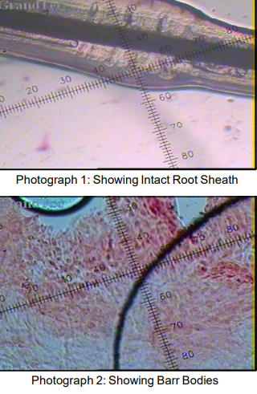
For Female Hair
Bulb of hair root was removed by blade of scalpel and root sheath was slipped off the shaft.
Root sheath stained by Aceto-Orcein
Material is compressed under a cover slip to obtain a monolayer of cells
100 cells were studied under 40X and 100X objective of microscope for Barr bodies.

Slide 21
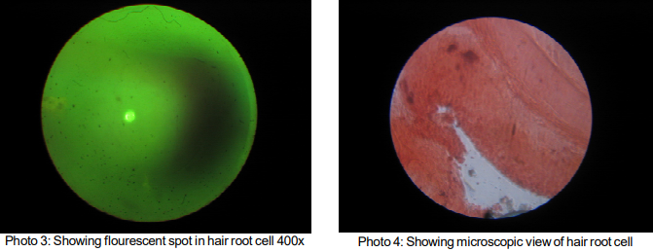
For Male Hair
Rooth sheath cells removed on slide, fixed and stained by Quinacrine dihydrochloride (sigma) for 5 mins, then treated with citrate phosphate buffer(pH 5.5) for 15 minutes for color conditioning.
Mounted with Phosphate buffer (pH 7.7).
Examined under 40X and 100X of Fluorescence microscope (Olympus Fluorescent microscope model BHF).

Slide 22
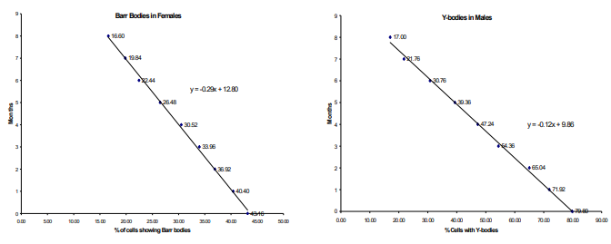
Results and Discussions:
Barr bodies were identifiable with frequency of 22% to 47% of cells for female hair
In the study, it was observed that in 18 cases , sex could be easily identifiable upto 8 months
In 1 case, it was not possible to determine sex after 3 months
In case of males, Y chromatin is present in 70%-90% cells.
Frequency of Y bodies was also 70%-90%.

Slide 23
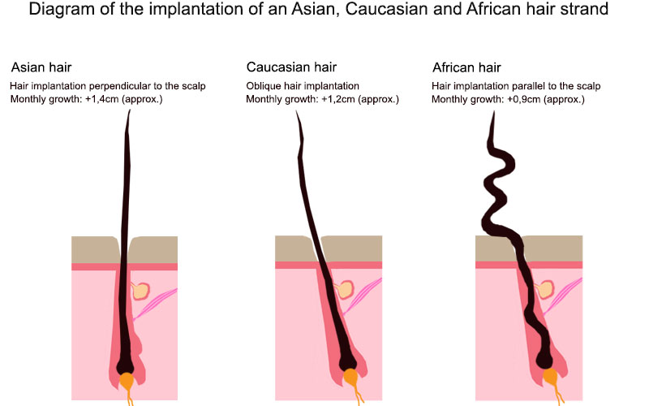
DETERMINATION OF RACE
Forensic examiners differentiate between hairs as-
Caucasoid (European ancestry)
Mongoloid (Asian ancestry)
Negroid (African ancestry)
All of which exhibit microscopic characteristics that distinguish one racial group from another.
Head hairs are generally considered best for determining race, although hairs from other body areas can be useful.

Slide 24
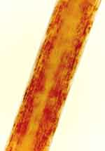
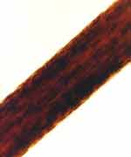
1) Caucasoid (European)
Hairs of Caucasoid or Caucasian origin can be of fine to medium coarseness, are generally straight or wavy in appearance, and exhibit colors ranging from blonde to brown to black.
The hair shafts of Caucasian hairs vary from round to oval in cross section and have fine to medium-sized, evenly distributed pigment granules.
This hair type grows diagonally and at a rate of about 1.2 centimeters per month.
2) Mongoloid (Asian)
Hairs of Mongoloid or Asian origin are regularly coarse, straight, and circular in cross section, with a wider diameter than the hairs of the other racial groups.
The outer layer of the hair, the cuticle, is usually significantly thicker than the cuticle of Negroid and Caucasian hairs, and the medulla, or central canal, is continuous and wide.
Mongoloid hair can have a characteristic reddish appearance as a product of its pigment and is either dark brown or black in color.
It grows perpendicularly to the scalp.

Slide 25
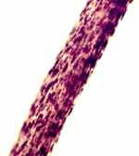
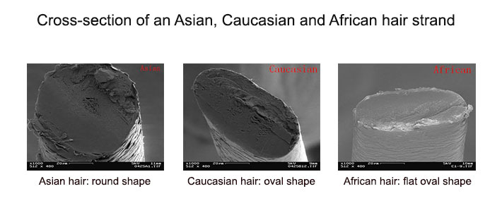
3) Negroid (African)
Hairs of Negroid or African origin are regularly curly or kinky, have a flattened cross section, and can appear curly, wavy, or coiled.
Twisting of the hair shaft, known as buckling, can be present, and the hair shaft frequently splits along the length.
This hair type has the slowest growth rate, due to its spiral structure that causes it to curl upon itself during growth. It grows almost parallel to the scalp.

Slide 26
Cases solved by hair evidence/ analysis
Cases involved: A. solved using hair analysis evidence for the confirmation of drug abuse by the accused.
B. solved using pet hair DNA

Slide 27
A. solved using hair analysis evidence for the confirmation of drug abuse by the accused.
Theory: A radioimmunoassay (hereinafter RIA) test, gas chromatography mass-spectrometry (GCMS) and confirmatory tests can be performed on hair to determine whether the individual has continued to use any kind of drugs (cocaine).
The theory behind the test is that cocaine fossilizes in the user's hair as it grows. Therefore, the test could purportedly indicate use of cocaine several months prior to the test (unlike blood and urine tests which only determine ingestion within days of the test).

Slide 28
CASE 1: Burgel v. Burgel, 141 A.2d 215, 533 N.Y.S. 2d 735 (1988) or No. 1651E, 1651 AE, New York Superior Court Appellate Division, 1988.
Factual background: During a child custody suit, the husband sought to have his wife submit to a hair test to determine if she had recently used cocaine. The Supreme Court of Westchester County, New York, ordered the wife to submit to the test. On appeal, the Supreme Court, Appellate Division affirmed.
Result: The Court initially stated that the broad scope of discovery takes on particular significance in child custody disputes, and in this case, the wife had placed her physical and mental condition in issue. Principally, the information sought concerned her continuing use of cocaine and thus, was relevant to her fitness to be granted custody of the children. The Court pointed out that the matter under review was a civil matter, in which the wife not only admitted to cocaine use, but had put her mental and physical health in issue. Particularly under these circumstances, argued the Court, neither the alleged novelty of the procedure nor the potential for its abuse provides a tenable analogy to the Fourth Amendment concerns articulated by the courts in the criminal cases cited by the dissent. The Court observed that even if the evidence was not admissible, the material may be discovered if it could lead to the discovery of admissible evidence. Finally, the court characterized the testing as “minimally intrusive”, and held that the trial court did not improvidently exercise its discretion in ordering the test.

Slide 29
CASE 2: In the Matter of the Adoption of Baby Boy L., 157 Misc. 2d 353, 596 N.Y.S. 2d 997 (1993).
Factual background: The adoptive parents of Baby Boy L. sought to introduce the results of a hair test of the biological parents’ hair to demonstrate cocaine use. The parties had previously stipulated to the production of hair samples for the purpose of testing for the presence of illicit drugs. Although the parties stipulated to the production of hair samples, the biological parents objected to the introduction of the testing results into evidence on the grounds that hair analysis (for purposes of detecting the extent of drug use) had not been shown to be endorsed by the general scientific community as reliable and scientifically acceptable. A hearing was held on the acceptance of hair testing in the scientific community, which included the testimony of the adoptive parents’ expert, Dr. Bidanset, as well as the biological parents’ expert, Dr. Manning. Dr. Bidanset testified that the hair analysis process was generally accepted by the scientific community, and was not only accurate, but becomes even more probative and reliable when used in conjunction with other related testing procedures, such as gas chromatography mass-spectrometry (GCMS). Dr. Manning testified that the hair analysis test was not entirely accepted by the Society of Forensic Toxicologists, but acknowledged that he personally and professionally regarded the test as accurate and reliable.
Result: The court concluded that the hair analysis was generally accepted in the scientific community, and was, therefore, admissible. Finally, the court observed that the criticism of the hair test centered on the need for individual testing controls, not the scientific validity of the process itself.

Slide 30
B. solved using pet hair DNA
CASE 1: Cat DNA solves Homicide
A British homicide case was solved by linking the genetic signature of cat hairs found on the body to the suspect's pet. Researchers say the technique demonstrates the power of pet DNA for forensic investigation.

Slide 31
Factual background: DNA readings from cat hairs have once again helped crack a homicide case — demonstrating the power of genetic pet databases to solve crimes. The case involves a suspect in Britain who was convicted of manslaughter after prosecutors drew a genetic link between his pet cat, Tinker, and cat hairs found at the crime scene. Investigators took advantage of a database of DNA from 152 cats in Britain.
"This is the first time cat DNA has been used in a criminal trial in the UK," Jon Wetton, the University of Leicester geneticist who led the cat DNA project, said in a statement. "We now hope to publish the database so it can be used in future crime investigations."
In July 2012, the dismembered torso of Hampshire resident David Guy was found on a Southsea beach, wrapped in a curtain on which eight cat hairs were found. Constables sent the hairs to California for analysis of the mitochondrial DNA, which is passed down from a mama cat to her kittens. Hairs from suspect David Hilder's cat were analyzed as well — and the tests came up with a match.

Slide 32
However, the prosecutors had to show how rare such a match might be for two random cats. That's when they brought in Wetton, who had already created a similar database for dogs while at Britain's Forensic Science Service. "We proposed creating a UK cat database from scratch," Wetton said.
Result: The Hampshire Constabulary paid for a series of tests of blood samples from British cats, conducted by Ph.D. student Barbara Ottolini with the cooperation of vets across the country. When 152 cats were tested, only three of the samples came back with a mitochondrial DNA match to the hairs on the curtain, confirming that the genetic signature was uncommon.
Those findings were factored into the case against Hilder, a neighbor of Guy's who was convicted of manslaughter last month in Winchester Crown Court and sentenced to life in prison.

Slide 33
REFERENCES
Taylor and Francis. Forensic Examination of Hair. London; Taylor& Francis e-Library, 2002.
Kintz, Salomone, ed. Hair Analysis in Clinical and Forensic Toxicology. Oxford; Elsevier Inc, 2015.
Microscopy of Hair Part 1: A Practical Guide and Manual for Human Hairs – http://www.fbi.gov, 2004.
Douglas W. Deedrick. Hairs, Fibers, Crime, and Evidence, Part 1. Forensic Science Communications, July 2000, Volume 2, Number 3.

Slide 34


